Slide 1

Statistics
Ruth Mburu

Slide 2

Topics
Five number summary and boxplot
Gaussian And Normal Distribution
Probability, Additive Rule, Multiplicative Rule
Permutation And combination
p value
Hypothesis testing, confidence interval, significance values
Type 1 and Type 2 error
Confidence Interval
One sample z test
One sample t test
Chi square test

Slide 3

Five Number Summary And Boxplots
The five number summary is a simple way to understand the key characteristics of a dataset. It consists of five numbers;
Minimum: the smallest value in the data set.
First quartile (Q1): The value below which 25% of the data falls.
Median (Q2): The middle value of the data set when it’s arranged in ascending order. It represents the point where half of the data is above it and half is below it.
Third quartile (Q3):The value below which 75% of the data falls.
Maximum: The largest value in the data set.
These five numbers provide a quick overview of the spread, center, and overall shape of the data set, making it easier to compare different sets of data and identify any outliers or unusual patterns.

Slide 4
Boxplots
The five number summary is often used to create a visual representation of the data called a boxplot or box and whisker plots. Here is how it works:
A box is drawing from the first quartile (Q1) to the third quartile(Q3) representing the middle 50% of the data.
A line whisker extends from the minimum value to the first quartile (Q1) and from the 3rd quartile (Q3) to the maximum value. These whiskers show the range of the data, excluding the outliers.
Outliers which are data points that lie significantly far from the rest of the data, are sometimes shown as individual points beyond the whiskers.
Box plots are useful for quickly visualizing the distribution of a data set, including its central tendency, spread and any potential outliers. They are particularly helpful for comparing multiple data sets or identifying patterns within a single data set.

Slide 5
Gaussian Distribution
It is also known as the normal distribution and is a fundamental concept in statistics and probability theory.
The normal distribution is a continuous probability distribution that is symmetrical around its mean, most of the observations cluster around the central peak, and the probabilities for values further away from the mean taper off equally in both directions. Extreme values in both tails of the distribution are similarly unlikely.
It is the most important probability distribution in statistics because it accurately describes the distribution of values for many natural phenomena. Characteristics that are the sum of many independent processes frequently followed normal distributions.

Slide 6
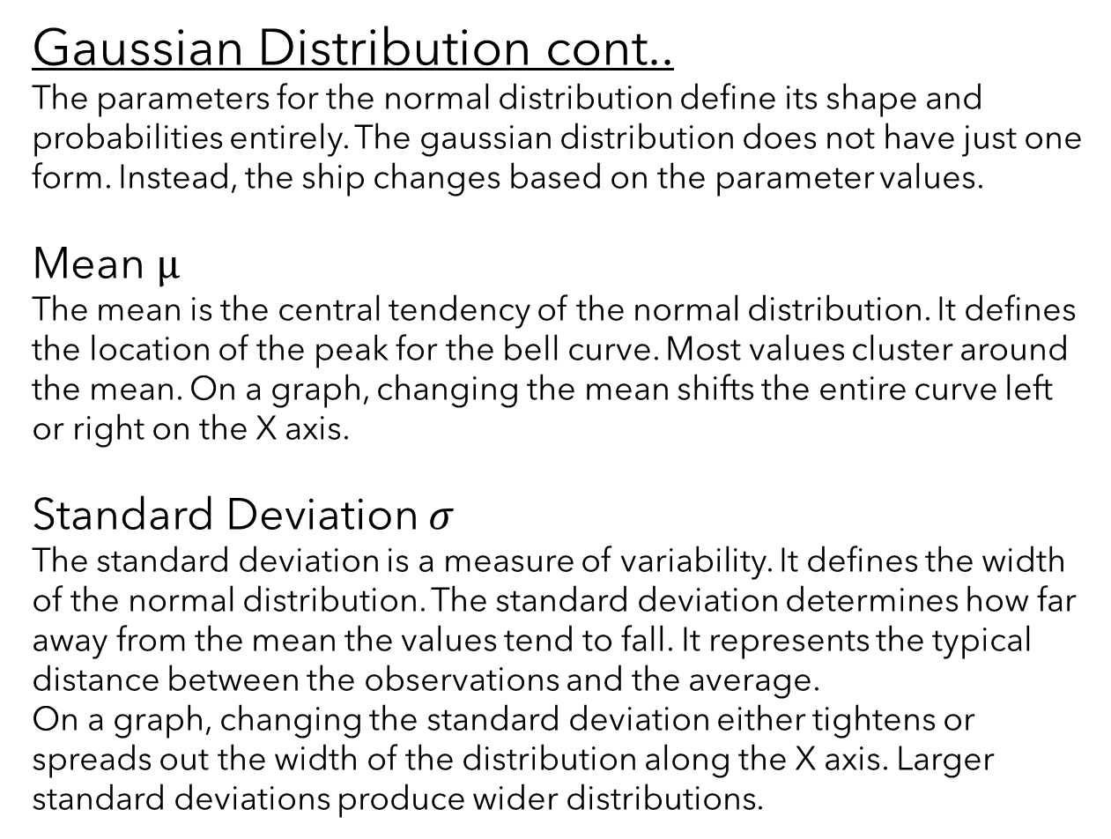
Gaussian Distribution cont..
The parameters for the normal distribution define its shape and probabilities entirely. The gaussian distribution does not have just one form. Instead, the ship changes based on the parameter values.
Mean μ
The mean is the central tendency of the normal distribution. It defines the location of the peak for the bell curve. Most values cluster around the mean. On a graph, changing the mean shifts the entire curve left or right on the X axis.
Standard Deviation $σ$
The standard deviation is a measure of variability. It defines the width of the normal distribution. The standard deviation determines how far away from the mean the values tend to fall. It represents the typical distance between the observations and the average.
On a graph, changing the standard deviation either tightens or spreads out the width of the distribution along the X axis. Larger standard deviations produce wider distributions.

Slide 7
Gaussian Distribution cont..
68-95-99.7% Rule
When you have normally distributed data, you can use the standard deviation to determine the proportion of the values that fall within a specified number of standard deviations from the mean. This rule describes the percentage of the data that fall within specific number of standard deviation from the mean for bell shaped curves.
In a Gaussian distribution, approximately 68% of the data falls within one standard deviation of the mean, 95% falls within two standard deviations, and 99.7% falls within three standard deviations.

Slide 8
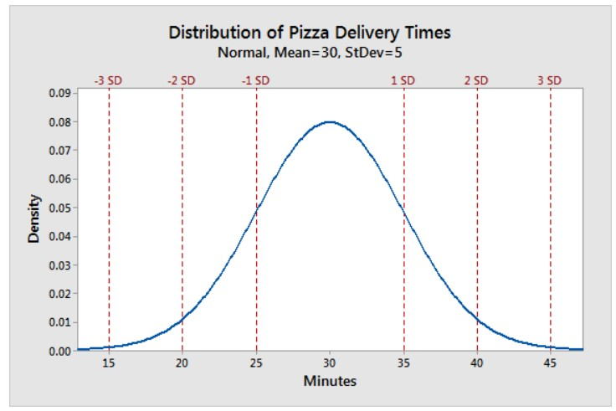
The chart below illustrates this property graphically;

Slide 9



Summary
Gaussian distribution is important because of its mathematical tractability and its frequent occurrence in natural phenomena.
Deviations from normality can have implications for the validity of statistical analysis, so understanding gaussian distribution is crucial for conducting accurate and meaningful statistical analysis.
Many statistical methods and techniques such as hypothesis testing, confidence intervals, and linear regression assume or are based on the assumption of normality.

Slide 10

Probability
The definition of probability is the likelihood of an event happening. Probability theory analyzes the chances of events occurring.
You can think of probabilities as being the following:
The long term proportion of times and event occurs during a random process.
The propensity of a particular outcome to occur.
Probability values range from zero to 1. Zero indicates that the event cannot happen while one represents an event that is guaranteed to happen. Values between zero and one denotes uncertainty over whether the event will occur.
As the likelihood increases, the event becomes more likely. The middle value of 0.5 signifies that the event is equally likely to happen or not.

Slide 11


Calculating Probability
Statistical hypothesis testing uses probabilities to help you evaluate hypothesis relevant to your study. P values are a well known type of likelihood and they allow you to determine whether your results are statistically significant.
At its most basic, a probability of an event occurring equals the following:
The numerator equals the number of ways an event can occur. We define what counts as an event based on our interests. For example we can choose to consider drawing a king from a deck of cards as an event.
The denominator represents the number of possible outcomes. The subject matter defines this value. For example there are 52 cards in a standard deck of cards.

Slide 12
Calculating Probability
Here are some of the other methods for finding probabilities that we’ll cover:
Using the multiplication rule to calculate probabilities.
Using permutations to collect probabilities.
Using combinations to calculate probabilities
Additive rule and Multiplicative Rule
Multiplicative Rule
This rule in probability allows you to calculate the joint probability of multiple events occurring together using known probabilities of those events individually There are two forms of this rule comma the specific and general multiplication rules

Slide 13
Calculating Probability
Multiplicative Rule cont..
But first we shall define independent and dependent events;
Independent events: the occurrence of one event does not affect the probability of the other event. For example, when flipping a coin getting ‘heads’ does not change the likelihood of getting ‘heads’ on the next coin flip.
Dependent events: the occurrence of one event doesn’t does affect the probability of the other event. For example, if you draw a king from a deck of cards and do not replace it, it causes the probability of drawing another king to decrease.

Slide 14


Calculating Probability
Multiplicative Rule cont..
Using the multiplicative rule, you can calculate the probability that events A&B occur jointly when you know the probability of event A and event B occurring individually.
The notation for the joint probability of A&B occurring is the following:
P(A $⋂$ B)
A
B
A $⋂$ B

Slide 15

Calculating Probability
Specific Multiplication Rule
Use the specific multiplication rule to calculate the joint probability of independent events. To use this rule, multiply the probabilities for the independent events.
With independent events, the occurrence of event a does not affect the likelihood of event B. This rule is not valid for dependent events.
Using probability notation, the specific multiplication rule is the following:
P(A $⋂$ B) = P(A) * P(B)

Slide 16
Calculating Probability
Specific Multiplication Rule Example
For example, to calculate the probability of obtaining heads during two consecutive coin flips, multiply the probability of heads on the first coin flip (0.5) by the probability of heads on the second coin flip (0.5).
0.5 X 0.5 = 0.25
The joint probability of two consecutive heads is 0.25.

Slide 17

Calculating Probability
General Multiplication Rule
Use the general multiplication rule to calculate joint probabilities for either dependent or independent events. When you have dependent events, you must use the general multiplication rule because it allows you to factor in how the occurrence of event A affects the likelihood of event B.
Using the standard notation the general multiplication rule is the following:
P(A $⋂$ B) = P(A) * P(B | A)
Or, the joint probability of A&B occurring equals the probability of a occurring multiplied by the conditional probability of B occurring given that a occurred.

Slide 18
Calculating Probability
General Multiplication Rule Example
An example of dependent events is drawing cards from a deck of cards without replacing. As you draw cards it affects the probability of the next card you draw.
Suppose you are interested in the probability of drawing hearts on 2 consecutive draws. Initially the deck has 13 hearts out of its 52 cards (13/52= 0.25). If you draw a heart for event one(event H1) that changes the probability of drawing another heart. The dependent probability of drawing that second heart(event H2) is now 12 /51 = 0.235.
In notation form:
P(H1 ∩ H2) = P(H1) * P(H2|H1)
0.25 * 0.235 = 0.059

Slide 19
Permutations and Combinations
Introduction
Permutations and combinations are fundamental concepts in statistics and combinatorics, dealing with the arrangements and selections of objects or values.
They play a crucial role in various statistical analysis, including probability calculations, sampling techniques, and experimental designs.
Permutations
Permutations in probability theory and other branches of mathematics refer to sequences where the order matters. For example 9385 is a permutation of a four digit pin because the order of numbers is crucial. When calculating probabilities, it is frequently necessary to calculate the number of possible permutations to determine an events probability.
An example is making a weak password in this case the order is crucial making them permutations. If we have letters ABC, the permutations of these letters can be ABC is CBA, BAC, BCA, CAB and CBA. If the password is BCA, entering CBA will not work. When you have at least two permutations, the number of permutations is greater than the number of combinations.

Slide 20
Permutations and Combinations
Permutations cont..
Calculating Permutations
When the outcomes in a permutation can repeat the calculation is done by taking the number of possibilities for each event and then multiply that number by itself X times, where X equals the number of events in the sequence.
For example, with four digit pins, each digit can range from zero to 9 giving us 10 possibilities for each digit. We have 4 digits. Consequently the number of permutations with repetition for these pins equals 10 * 10 * 10 * 10 = 10,000.
We can write this mathematically as n^{r}
Where; n = the number of possible outcomes for each event. For instance, n = 10 for the PIN example.
r = the size of each permutation. For example, r = 4 for a four-digit pin.

Slide 21
Permutations and Combinations
Permutations cont..
Calculating Permutations
For permutations without replication or repetition factorials are crucial concepts. The number of permutations for n unique objects is n!. This number snowballs as the number of items increases.
In some cases, do you want to consider only a portion of the possible permutations. Using the following formula to calculate the number of arrangements of r items from n objects.
For example we have a bookshelf where we can fit only 5 out of 10 books on the shelf how many permutations of five books are possible using our ten books?

Slide 22
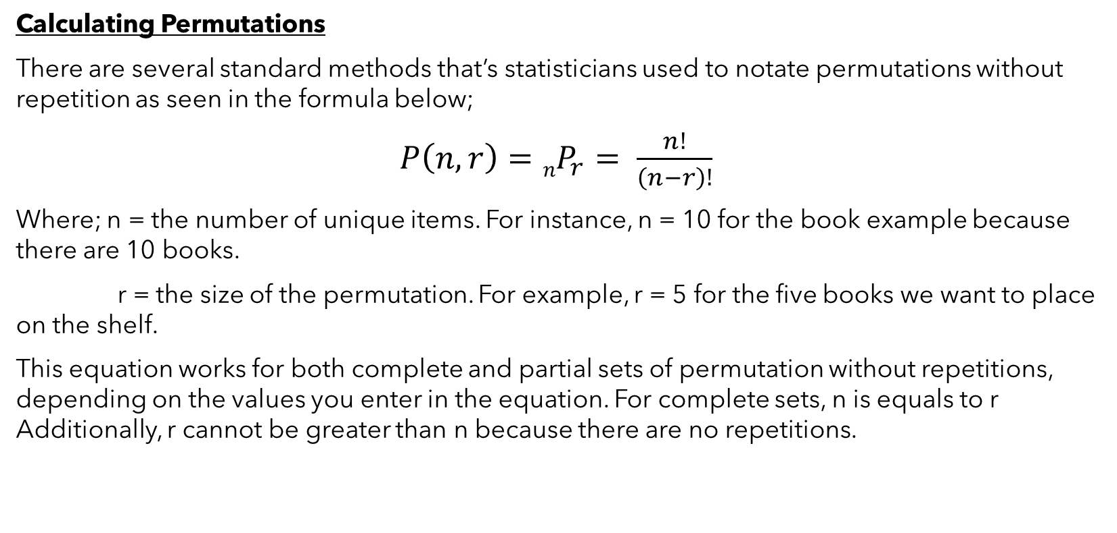
Permutations and Combinations
Permutations cont..
Calculating Permutations
There are several standard methods that’s statisticians used to notate permutations without repetition as seen in the formula below;
$P\left(n,r\right)=nP_{r}= \frac{n!}{\left(n−r\right)!}$
Where; n = the number of unique items. For instance, n = 10 for the book example because there are 10 books.
r = the size of the permutation. For example, r = 5 for the five books we want to place on the shelf.
This equation works for both complete and partial sets of permutation without repetitions, depending on the values you enter in the equation. For complete sets, n is equals to r Additionally, r cannot be greater than n because there are no repetitions.

Slide 23
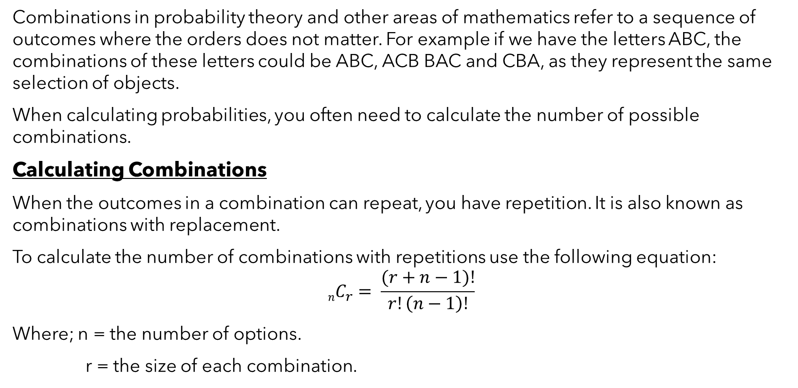
Permutations and Combinations
Combinations
Combinations in probability theory and other areas of mathematics refer to a sequence of outcomes where the orders does not matter. For example if we have the letters ABC, the combinations of these letters could be ABC, ACB BAC and CBA, as they represent the same selection of objects.
When calculating probabilities, you often need to calculate the number of possible combinations.
Calculating Combinations
When the outcomes in a combination can repeat, you have repetition. It is also known as combinations with replacement.
To calculate the number of combinations with repetitions use the following equation:
$$nC_{r}= \frac{(r+n−1)!}{r!\left(n−1\right)!}$$
Where; n = the number of options.
r = the size of each combination.

Slide 24
Permutations and Combinations
Combinations cont..
Calculating Combinations
Imagine you own a pizza restaurant, and we have six toppings from which customers choose from. We also have a special offer for pizzas with three toppings. How many potential combinations fall under our special?
To solve these types of problems, you need to determine the n and r for the equation. The number of possible outcomes equals the number of choices for toppings, which is six. The size of each combination is three because that’s what we’re allowing for our special. So, n = 6 and r = 3.

Slide 25
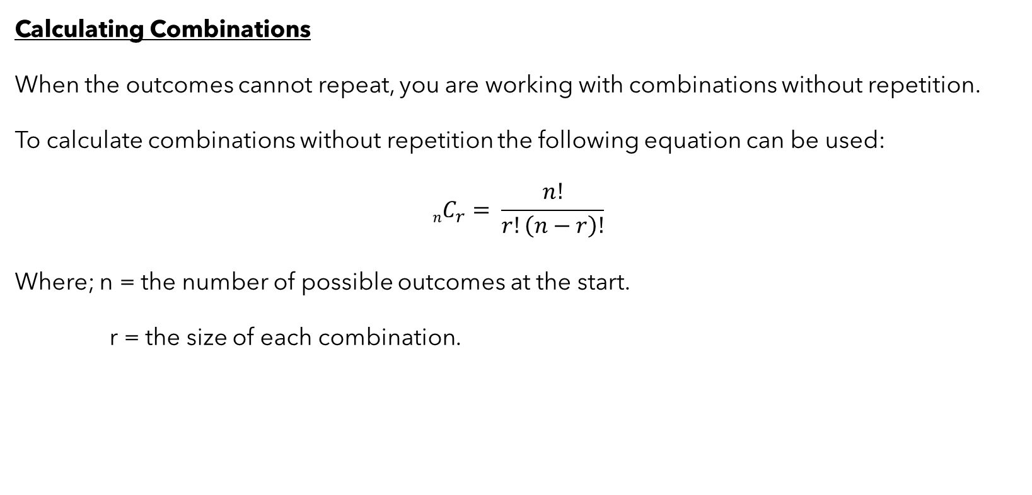
Permutations and Combinations
Combinations cont..
Calculating Combinations
When the outcomes cannot repeat, you are working with combinations without repetition.
To calculate combinations without repetition the following equation can be used:
$$nC_{r}= \frac{n!}{r!\left(n−r\right)!}$$
Where; n = the number of possible outcomes at the start.
r = the size of each combination.

Slide 26
Permutations and Combinations
Combinations cont..
Calculating Combinations
For example, imagine a process that draws five people to be on a team out of a pool of 30. The order in which the process draws team members does not matter. Suppose a team comprises of A, B, C, D, E. That is equivalent to a team where the same people are drawn but in a different order. Additionally, because the process can select a person only once, there is no repetition.
In this example n=30 because we are drawing from a pool of 30 candidates. R = 5 because the team can have only 5 members.

Slide 27
Hypothesis Tests
Introduction
Hypothesis testing is a vital process in inferential statistics where the goal is to use sample data to draw conclusions about an entire population. In the testing process, you use significance levels and P values to determine whether the test results are statistically significant.
Key Concepts
Null hypothesis, H₀
The null hypothesis is a statement of no effect or difference. It represents the status quo or the assumption that there is no relationship or difference between groups.
Alternate Hypothesis, H₁ or H_{a}
The alternate hypothesis is the hypothesis of interest, asserting that there is an effect or difference. It represents the opposite of the null hypothesis and is what researchers aim to provide evidence for.

Slide 28
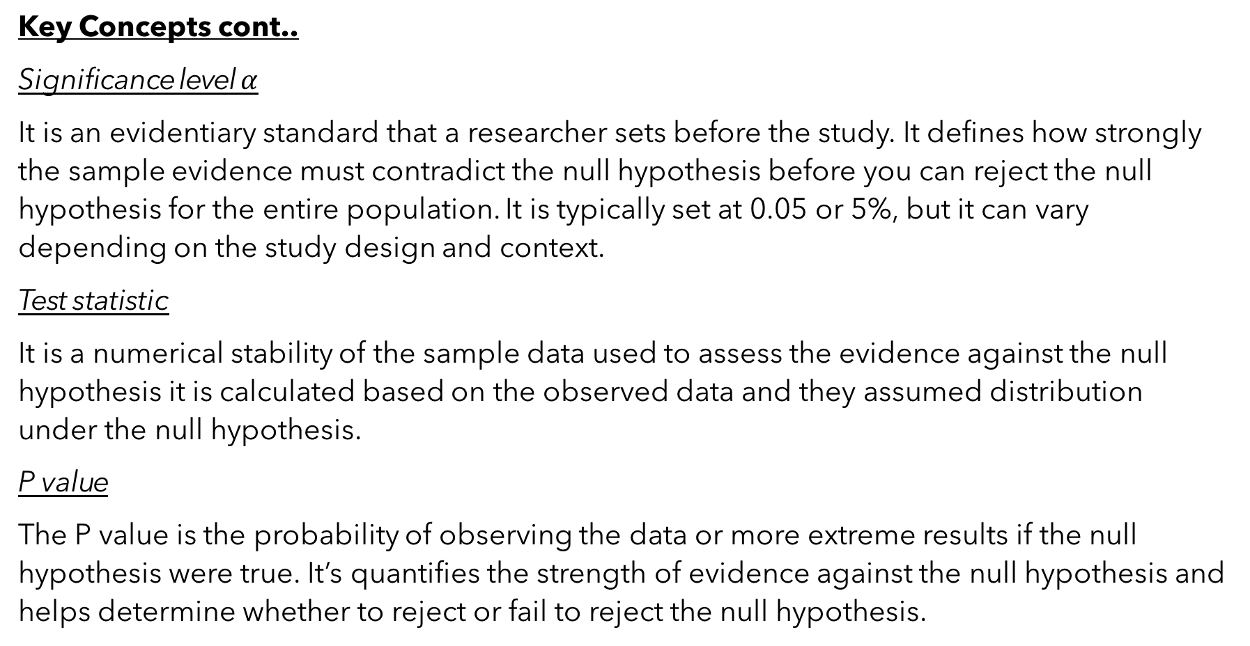
Hypothesis Tests
Key Concepts cont..
Significance level $α$
It is an evidentiary standard that a researcher sets before the study. It defines how strongly the sample evidence must contradict the null hypothesis before you can reject the null hypothesis for the entire population. It is typically set at 0.05 or 5%, but it can vary depending on the study design and context.
Test statistic
It is a numerical stability of the sample data used to assess the evidence against the null hypothesis it is calculated based on the observed data and they assumed distribution under the null hypothesis.
P value
The P value is the probability of observing the data or more extreme results if the null hypothesis were true. It’s quantifies the strength of evidence against the null hypothesis and helps determine whether to reject or fail to reject the null hypothesis.

Slide 29
Hypothesis Tests
Steps in hypothesis testing
1. Formulate hypothesis
State the null hypothesis H₀ and then alternative hypothesis H₁ based on the research question and the phenomenon of interest
2. Select significance level 𝛼
Choose a significance level that represents the maximum allowable probability of making a type 1 error rejecting the null hypothesis when it is true.
3. Collect data and calculate test statistic
Collect sample data and calculate the test statistic based on the observed data and the assumed distribution under the null hypothesis.

Slide 30
Hypothesis Tests
4. Make decision
Compare the P value to the significance level:
If the P value is less than the significance level reject the null hypothesis in favor of the alternative hypothesis.
If the P value is greater than or equal to the significance level, failed to reject the null hypothesis.
Interpretation
If the null hypothesis is rejected, it suggests strong evidence against the null hypothesis in favor of the alternative hypothesis. If the null hypothesis is not rejected, it indicates insufficient evidence to conclude that the alternative hypothesis is true.

Slide 31
Hypothesis Tests
Types of errors
Hypothesis tests are not 100% accurate because they use a random sample to draw conclusions about entire populations. When you perform a hypothesis test, there are two types of errors related to drawing an incorrect conclusion.
Type I error : (False Positive) Rejecting venal hypothesis when it is actually true. The probability of type 1 error is equal to the significance level.
Type II error: (False negative) failing to reject the null hypothesis when it is actually false. The probability of type 2 error depends on factors such as sample size, effect size, and variability.

Slide 32
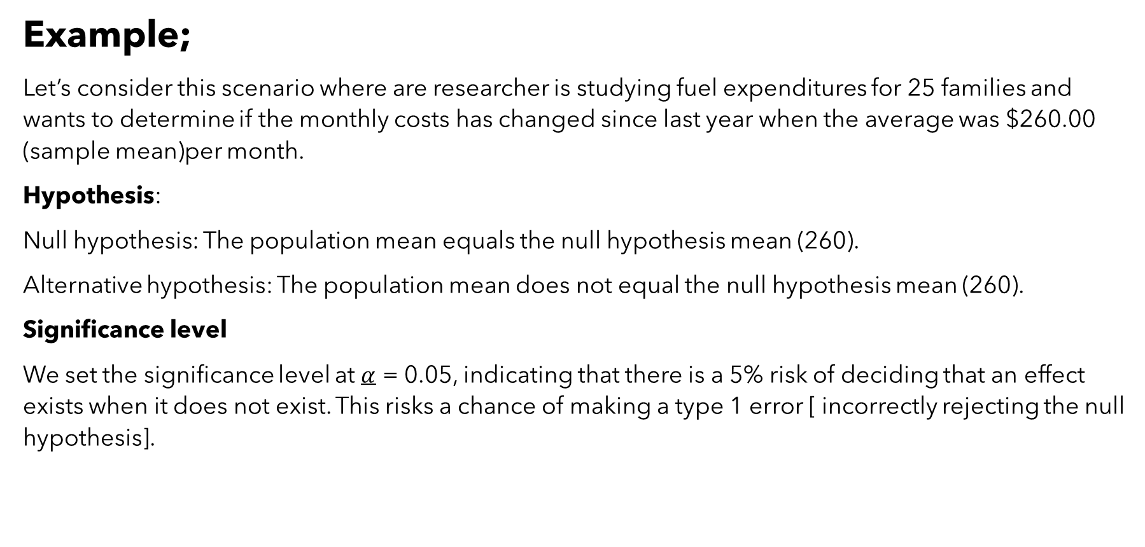
Hypothesis Tests
Example;
Let’s consider this scenario where are researcher is studying fuel expenditures for 25 families and wants to determine if the monthly costs has changed since last year when the average was $260.00 (sample mean)per month.
Hypothesis:
Null hypothesis: The population mean equals the null hypothesis mean (260).
Alternative hypothesis: The population mean does not equal the null hypothesis mean (260).
Significance level
We set the significance level at $α$ = 0.05, indicating that there is a 5% risk of deciding that an effect exists when it does not exist. This risks a chance of making a type 1 error [ incorrectly rejecting the null hypothesis].

Slide 33
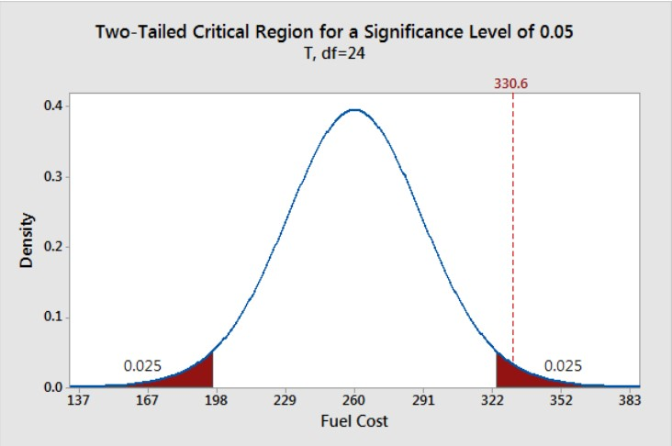
Hypothesis Tests
Example;
The significance level defines how far the sample value must be from the null value before we can reject the null. The percentage of the area under the curve that is shaded equals the probability that the sample value will fall in those regions if the null hypothesis is correct.
Each region has a probability of 0.025, which sums to our desired total of 0.05. These shaded areas are called the critical region for a two-tailed hypothesis test.
he critical region defines sample values that are improbable enough to warrant rejecting the null hypothesis. If the null hypothesis is correct and the population mean is 260, random samples (n=25) from this population have means that fall in the critical region 5% of the time.

Slide 34
Hypothesis Tests
Collect data and calculate test statistic
The researcher collected a random sample and found that this year’s sample mean (330.6) is greater than last year’s mean (260).
Hypothesis test
Here we calculate the p-value based on the sample data and the assumed distribution. First, we need to calculate the effect that is present in our sample. The effect is the distance between the sample value and null value: 330.6 – 260 = 70.6.
After, shade the regions on both sides of the distribution that are at least as far away as 70.6 from the null (260 +/- 70.6). This process graphs the probability of observing a sample mean at least as extreme as our sample mean.

Slide 35
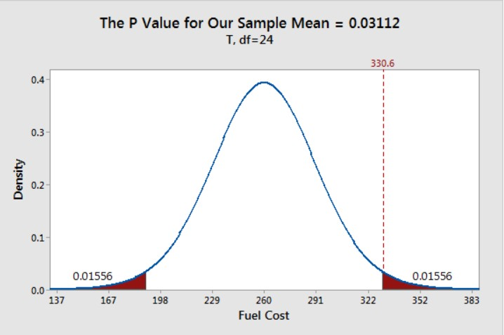
Hypothesis Tests
Example cont..;
The total probability of the two shaded regions is 0.03112.
If the null hypothesis value (260) is true and you drew many random samples, you’d expect sample means to fall in the shaded regions about 3.1% of the time. In other words, you will observe sample effects at least as large as 70.6 about 3.1% of the time if the null is true.
That’s the P value!
If your P value is less than or equal to your alpha level, reject the null hypothesis.
The P value results are consistent with our graphical representation. The P value of 0.03112 is significant at the alpha level of 0.05

Slide 36
Hypothesis Tests
Decision
Using the significance level of 0.05, the sample effect is statistically significant.
We reject the null hypothesis. Our data support the alternative hypothesis, which states that the population mean doesn’t equal 260. We can conclude that mean fuel expenditures have increased since last year.
Hypothesis tests are crucial when you want to use sample data to make conclusions about a population because these tests account for sample error. Using significance levels and P values to determine when to reject the null hypothesis improves the probability that you will draw the correct conclusion.

Slide 37
Confidence Interval
Introduction
A confidence interval is a range of values that we estimate contains the true population parameter with a certain level of confidence. It is calculated from sample data using a statistical formula or method. Typically based on the sample mean, but can be used for other parameters as well.
Interpretation
For example a 95% confidence interval for the average height of students might be 150 cm to 160 cm. This means that we are 95% confident that the true average height falls within this range.
Levels of confidence
Represents the probability that the true parameter falls within the confidence interval. Common levels include 90%, 95% and 99%.

Slide 38
Confidence Interval
Width of interval
Narrower intervals indicate more precise in estimates. With depends on sample size, variability of data, and chosen level of confidence.
Difference between significance level and confidence interval
The significance level chart centers on the null value, and we shade the outside 5% of the distribution.
Conversely, the confidence interval graph centers on the sample mean, and we shade the center 95% of the distribution.

Slide 39
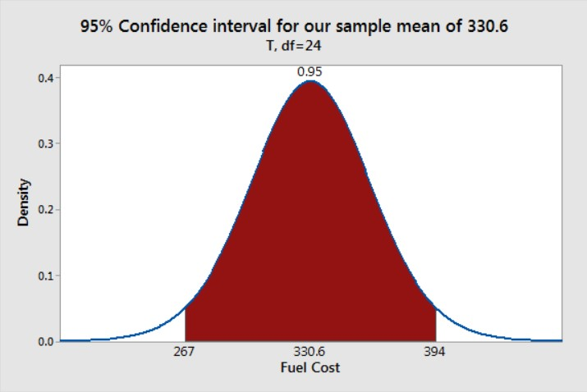
Confidence Interval
The shaded range of sample means [267 - 394] covers 95% of this sampling distribution. This range is the 95% confidence interval for our sample data. We can be 95% confident that the population mean for fuel costs fall between 267 and 394.
The relationship between the confidence level and the significance level for a hypothesis test is as follows:
Confidence level = 1 – Significance level (alpha)
For example, if your significance level is 0.05, the equivalent confidence level is 95%.

Slide 40

Thank you

